Slide 1

Estimation of optical properties of Photonic Crystal Fiber using Machine Learning
Presented by:
Gadliwala Priyankkumar Umeshkumar
MBI2023007
Under Supervision of:
Dr. Akhilesh Tiwari
IIIT Allahabad
June 2025

Slide 2
Contents
Introduction
Problem Statement
Objectives
Methodology
Result
Conclusion
References

Slide 3
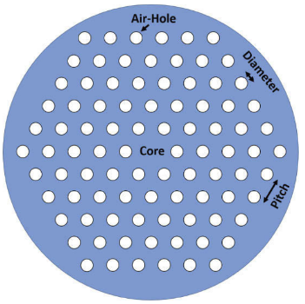
Introduction
Photonic Crystal Fiber (PCF) is a specialized optical fiber with periodic arrangement of air holes.
Studying and understanding the optical properties of PCFs is crucial because of applications in fiber optic communication, fiber lasers, Sensing etc.
Optical properties of PCF are effective refractive index, effective mode area , dispersion and confinement loss.
Figure 1 - Cross-section of a solid-core hexagonal PCF
(Sunny Chugh et al, 2019)

Slide 4
Problem Statement
How can machine learning models be effectively used to estimate key optical properties of photonic crystal fibers (such as N_{eff}, A_{eff}, dispersion, and confinement loss) based on their geometric parameters, thereby minimizing the reliance on computationally numerical simulations?

Slide 5
Objectives
To develop and evaluate predictive models for the optical properties of photonic crystal fibers (PCFs) using various machine learning algorithms.
To precisely estimate the optical properties for a range of PCF parameters more efficiently than traditional simulation methods.

Slide 6
Dataset Description
core-ref-index | clad-ref-index | no_of_ rings | diameter of airhole | pitch | wl | neff | Aeff | dispersion | confinement loss | confinement loss (in log10)
1.444 | 1 | 4 | 0.6 | 0.8 | 1.58333 | 1.33418 | 5.0249 | -457.994 | 155.015 | 2.190373725
1.444 | 1 | 4 | 0.6 | 0.8 | 1.41322 | 1.34653 | 2.81363 | -502.289 | 46.1727 | 1.664385271
1.444 | 1 | 4 | 0.6 | 0.8 | 1.27612 | 1.35866 | 1.96006 | -432.099 | 11.3387 | 1.054563265
1.444 | 1 | 4 | 0.6 | 0.8 | 1.16327 | 1.37008 | 1.55828 | -314.841 | 2.56622 | 0.409293885
1.444 | 1 | 4 | 0.6 | 0.8 | 1.06875 | 1.38044 | 1.33372 | -198.731 | 0.575763 | -0.239756247
1.444 | 1 | 4 | 0.6 | 0.8 | 0.988439 | 1.38965 | 1.19244 | -101.214 | 0.132934 | -0.876363927
1.444 | 1 | 4 | 0.6 | 0.8 | 0.919355 | 1.39773 | 1.09609 | -24.5121 | 0.0323678 | -1.489886818
1.444 | 1 | 4 | 0.6 | 0.8 | 0.859296 | 1.40479 | 1.02642 | 34.0942 | 0.00843769 | -2.073776435
1.444 | 1 | 4 | 0.6 | 0.8 | 0.806604 | 1.41095 | 0.97377 | 78.2568 | 2.37E-03 | -2.625315795
1.444 | 1 | 4 | 0.6 | 0.8 | 0.76 | 1.41634 | 0.932557 | 111.311 | 7.17E-04 | -3.144388786
1.444 | 1 | 4 | 0.6 | 0.8 | 0.718487 | 1.42105 | 0.899382 | 135.952 | 2.33E-04 | -3.632040587
1.444 | 1 | 4 | 0.6 | 0.8 | 0.681275 | 1.4252 | 0.872059 | 154.254 | 8.13E-05 | -4.089776462
1.444 | 1 | 4 | 0.6 | 0.8 | 0.647727 | 1.42886 | 0.84913 | 167.781 | 3.02E-05 | -4.519277492
1.444 | 1 | 4 | 0.6 | 0.8 | 0.617329 | 1.4321 | 0.829586 | 177.696 | 1.20E-05 | -4.922196202
1.444 | 1 | 4 | 0.6 | 0.8 | 0.589655 | 1.43498 | 0.812704 | 184.869 | 5.01E-06 | -5.300207353
1.444 | 1 | 4 | 0.6 | 0.8 | 0.564356 | 1.43755 | 0.797961 | 189.944 | 2.21E-06 | -5.654881235
1.444 | 1 | 4 | 0.6 | 0.8 | 0.541139 | 1.43985 | 0.78496 | 193.406 | 1.03E-06 | -5.98775348
1.444 | 1 | 4 | 0.6 | 0.8 | 0.519757 | 1.44192 | 0.773402 | 195.622 | 5.01E-07 | -6.300314867
1.444 | 1 | 4 | 0.6 | 0.8 | 0.5 | 1.44378 | 0.76305 | 196.867 | 2.55E-07 | -6.593988107
Table 1 – Dataset

Slide 7
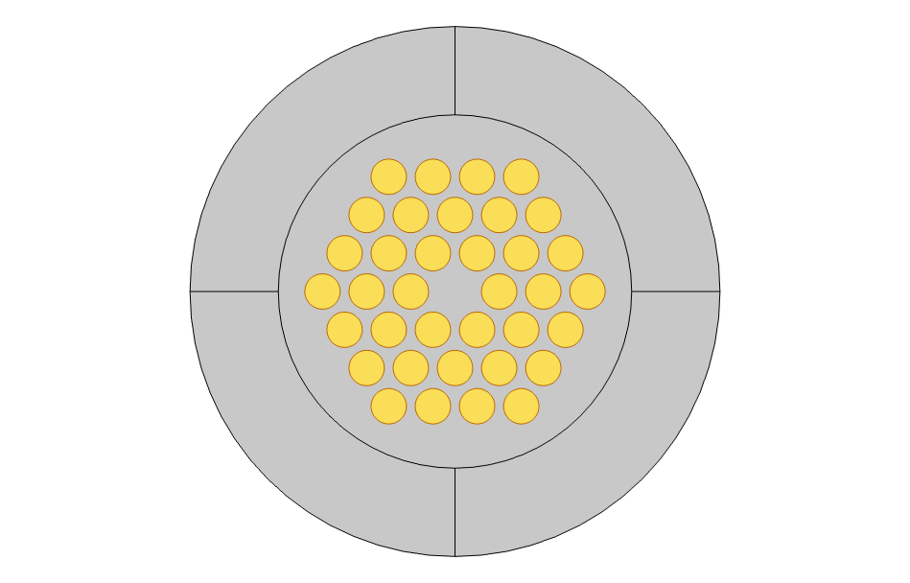
Input Parameters
Refractive Index of Core
Refractive Index of Cladding
Number of Rings
Diameter of Airholes
Pitch
Wavelength
Parameters | Range
Numbers of Rings (Nr) | 3,4
Diameter of holes (D) | 0.6 to 2.0 µm
Pitch | 0.4 to 1.4 µm
wavelength | 0.5 to 1.8 µm
Figure 2 – Air holes in PCF

Slide 8
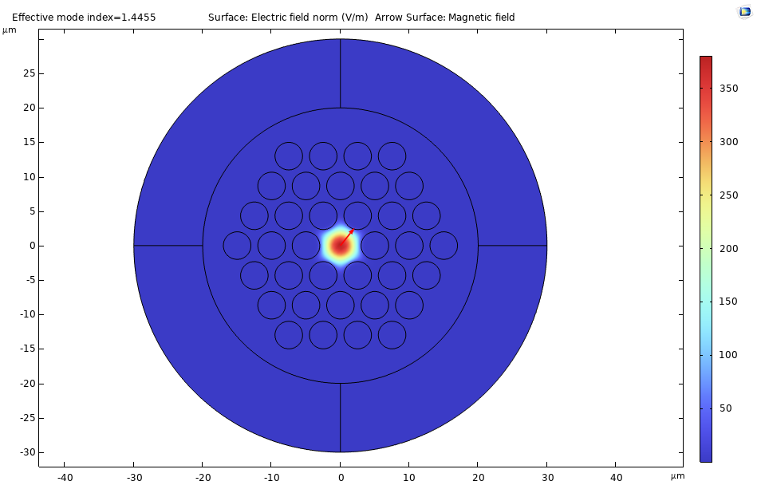
Output Parameters
Effective Refractive Index (Neff)
Effective Mode Area (Aeff)
Dispersion
Confinement loss (in log 10)
Figure 3 – PCF

Slide 9
Methodology
1. PCF Designing and Modeling
2. Data generation using COMSOL Multiphysics
3. Data Preprocessing

Slide 10
Methodology (continue)
Machine Learning Model Development
1. Artificial Neural Network(ANN)
2. Random Forest Regression(RFR)
3. Support Vector Regression(SVR)
4. K-Nearest Neighbour Regression(KNNR)
Model Evaluation 1. Mean Squared Error (MSE)
2. Mean Absolute Percentage Error (MAPE)
3. R^2 score

Slide 11
Result - ANN
Prediction Parameter | MSE | MAPE | R² Score
Neff | 0.000009 | 0.18% | 0.9929
Aeff | 0.005119 | 3.69% | 0.995
Dispersion | 886.926 | 16.91% | 0.9189
Confinement Loss (in log10) | 0.565 | 38.03% | 0.9842
Table 2 - ANN Model Performance Summary

Slide 12
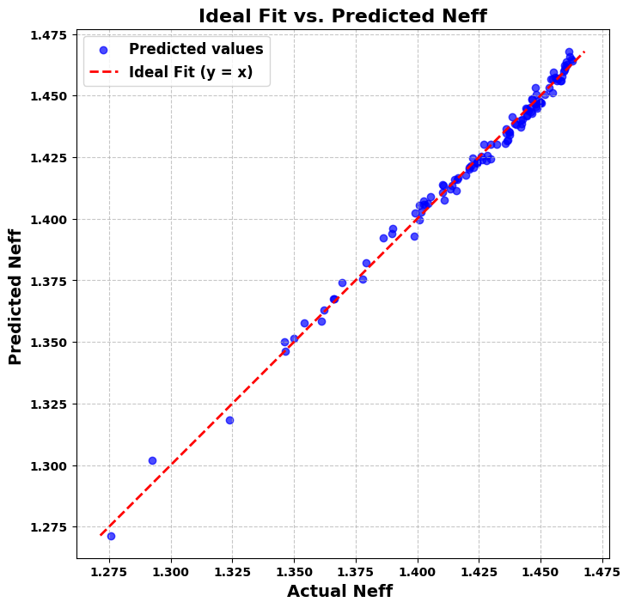
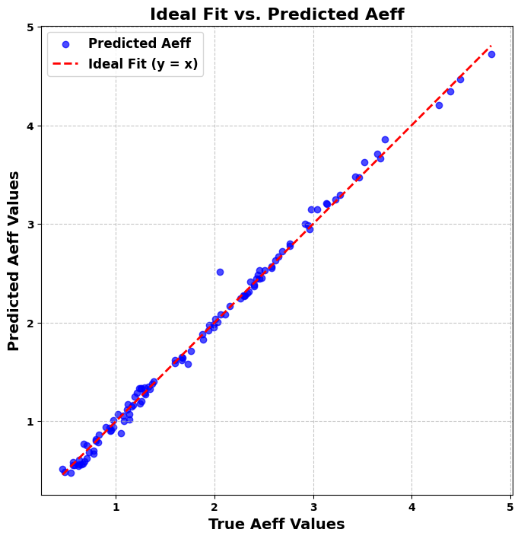
Result - ANN
Figure 4 – Actual vs Predicted Neff
Figure 5 – Actual vs Predicted Aeff

Slide 13
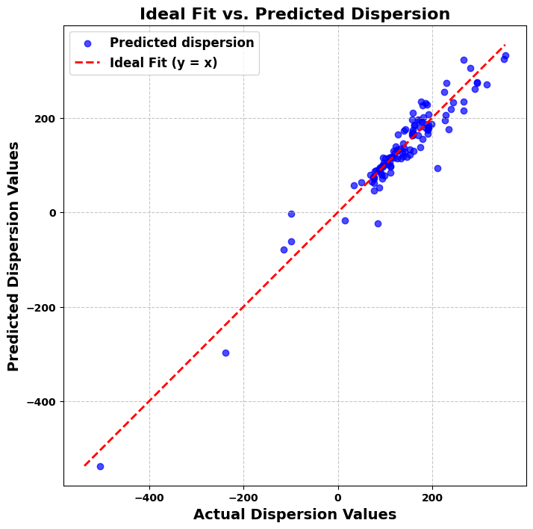
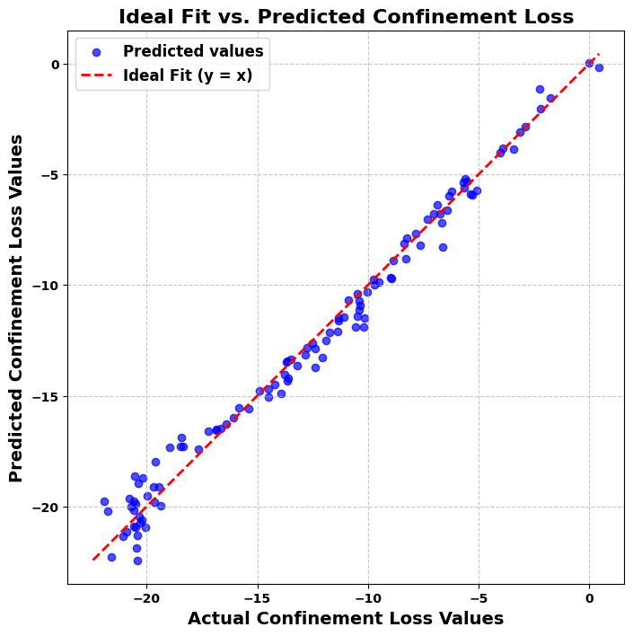
Result - ANN
Figure 6 – Actual vs Predicted Dispersion
Figure 7 – Actual vs Predicted Confinement loss
(in log 10)

Slide 14
Result - RFR
Parameter | MSE | MAPE (%) | R² Score
Neff | 2.097 × 10⁻⁵ | 0.18% | 0.990
Aeff | 0.0258 | 2.87% | 0.979
Dispersion | 277.42 | 19.04% | 0.992
Confinement loss (in log10) | 1.5649 | 24.63% | 0.965
Table 3 - RFR Model Performance Summary

Slide 15
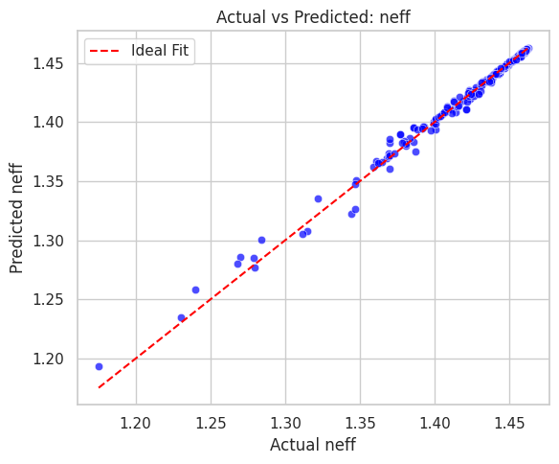
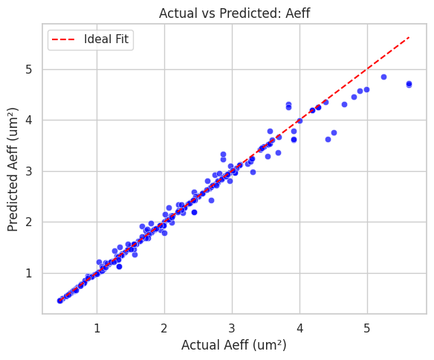
Result - RFR
Figure 8 – Actual vs Predicted Neff
Figure 9 – Actual vs Predicted Aeff

Slide 16
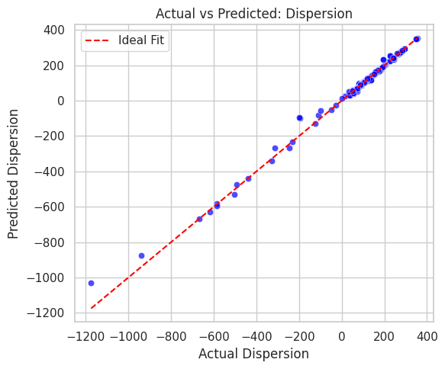
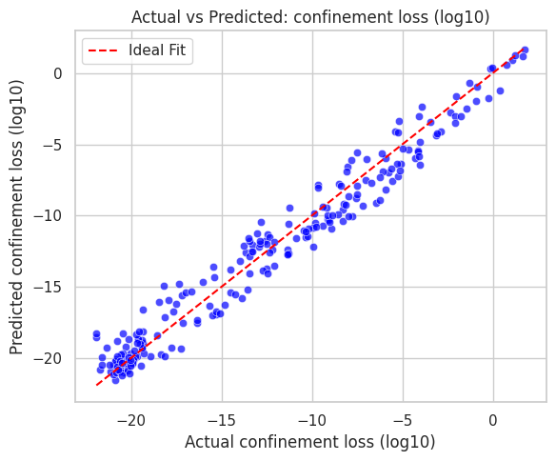
Result - RFR
Figure 10 – Actual vs Predicted Dispersion
Figure 11 – Actual vs Predicted Confinement loss
(in log 10)

Slide 17
Result - SVR
Parameters | MSE | MAPE | R² Score
Neff | 8.98 × 10⁻¹⁰ | 0.001% | 0.9999
Aeff | 0.00329 | 0.18% | 0.9966
Dispersion | 29.46 | 1.06% | 0.9986
Confinement Loss (log₁₀) | 0.217 | 2.18% | 0.9943
Table 4 - SVR Model Performance Summary

Slide 18
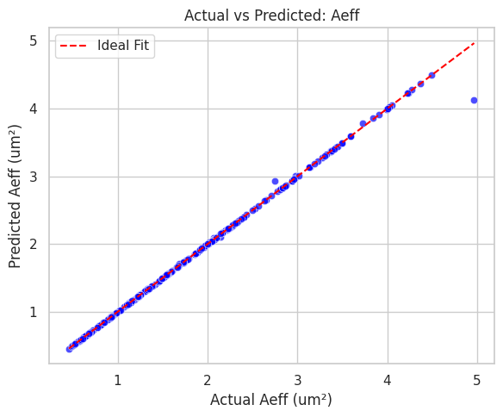
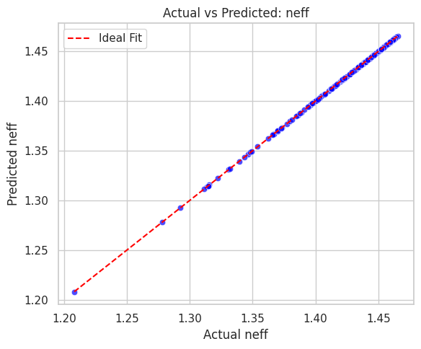
Result - SVR
Figure 12 – Actual vs Predicted Neff
Figure 13 – Actual vs Predicted Aeff

Slide 19
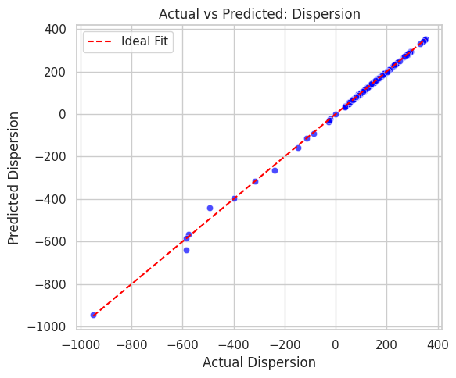
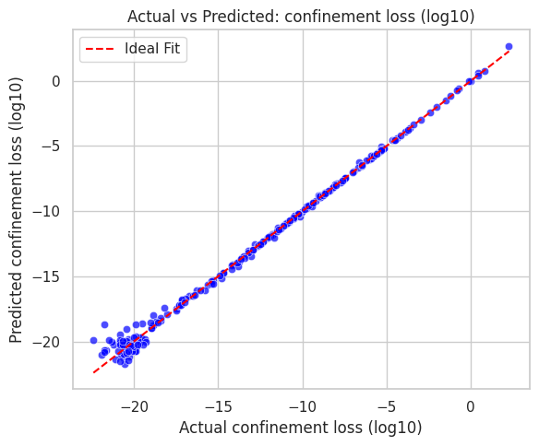
Result - SVR
Figure 14 – Actual vs Predicted Dispersion
Figure 15 – Actual vs Predicted Confinement loss
(in log 10)

Slide 20
Result – KNNR
Parameter | MSE | MAPE | R² Score
Neff | 0.000036 | 0.19% | 0.9777
Aeff | 0.029987 | 1.99% | 0.9699
Dispersion | 2037.90947 | 91.08% | 0.908
Confinement Loss (in log10) | 0.4868 | 17.75% | 0.9872
Table 5 - KNNR Model Performance Summary

Slide 21
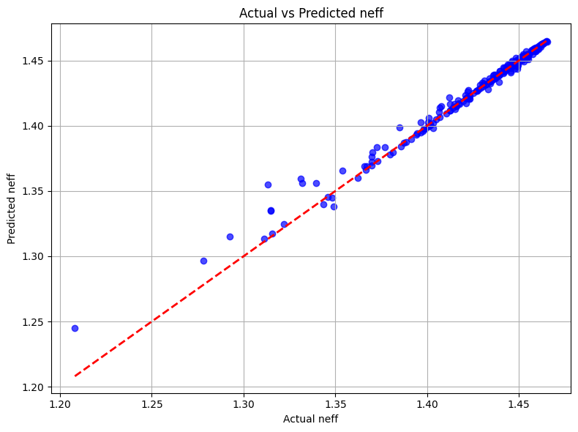
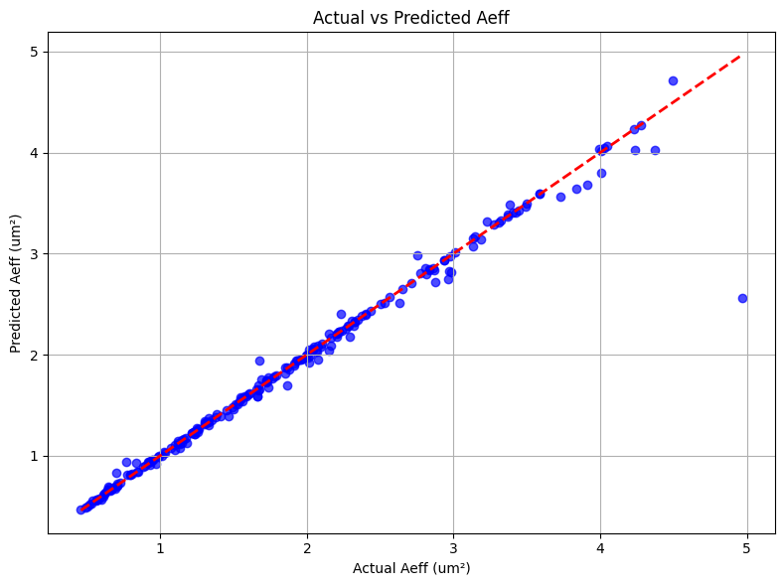
Result– KNNR
Figure 16 – Actual vs Predicted Neff
Figure 17 – Actual vs Predicted Aeff

Slide 22
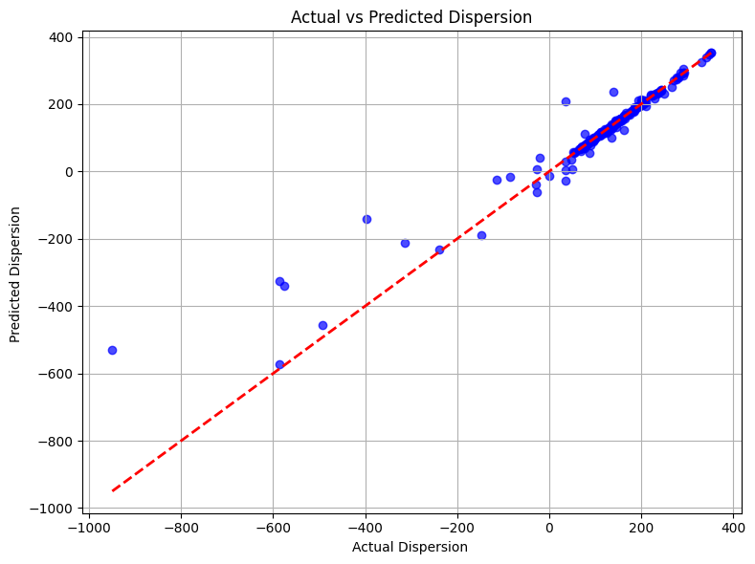
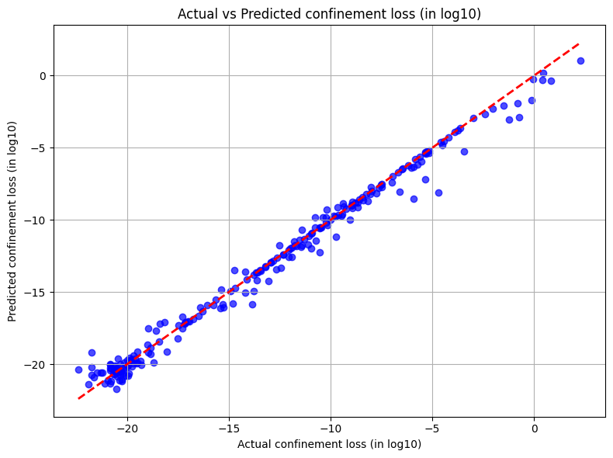
Result – KNNR
Figure 18 – Actual vs Predicted Dispersion
Figure 19 – Actual vs Predicted Confinement loss
(in log 10)

Slide 23
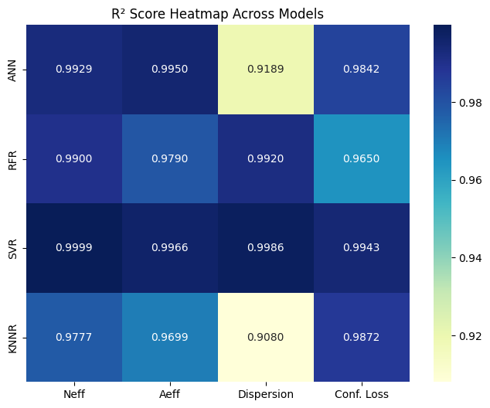
Model Performance Summary
Figure 20 - Heatmap offering a quick visual of model performance across metrics.

Slide 24
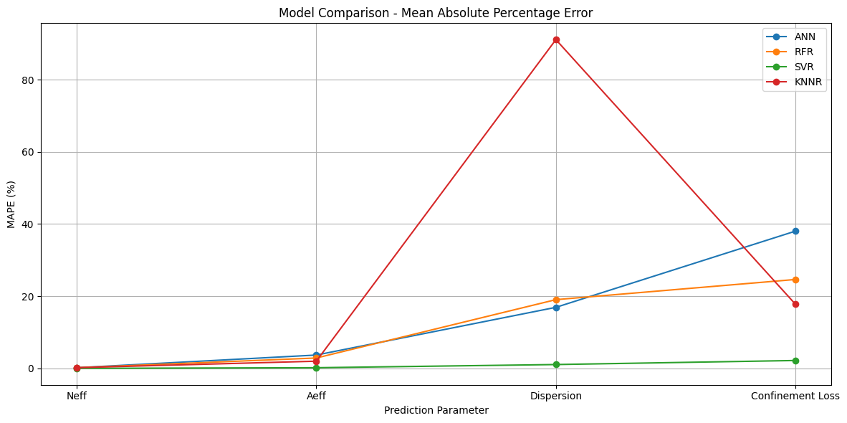
Model Performance Summary
Figure 21 - Line plot demonstrating MAPE (%) trends for each model across optical properties.

Slide 25
Conclusion
SVR emerged as the most accurate and robust model for all four optical parameters, with particularly outstanding results in Neff, Aeff, and Dispersion.
ANN was the next best, offering strong generalization across all parameters, especially in the presence of nonlinearities.
RFR performed very well too, especially for Neff and Aeff, and stands out for its interpretability and resistance to overfitting.
KNNR, while simpler, proved effective for some parameters but lacked consistency in more complex predictions like dispersion.
Machine learning techniques can be employed to accurately predict the important properties for a silica core photonic crystal fiber design.
We can predict the optical properties in contrast of needing few minutes with numerical simulations.

Slide 26
References
Sk Md Abdul Kaium and Md Aslam Mollah, "Optical properties estimation of photonic crystal fiber using Gaussian process regression," Opt. Continuum 3, 1369-1388 (2024)
M. A. Jabin and M. P. Fok, "Prediction of 12 Photonic Crystal Fiber Optical Properties Using MLP in Deep Learning," in IEEE Photonics Technology Letters, vol. 34, no. 7, pp. 391-394, 1 April1, 2022.
Sunny Chugh, Aamir Gulistan, Souvik Ghosh, and B. M. A. Rahman, "Machine learning approach for computing optical properties of a photonic crystal fiber," Opt. Express 27, 36414-36425 (2019)

Slide 27
Thank-You

